Slide 1
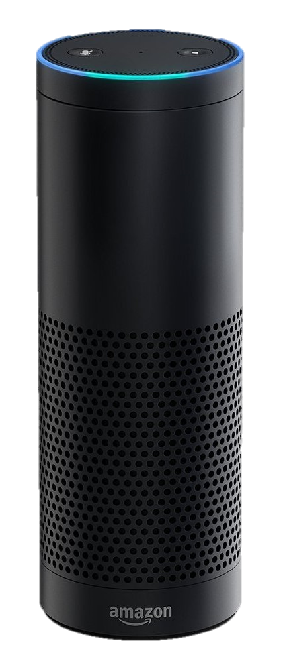

Introducing The Amazon Echo
A new way to stay connected
Baylee Diedrich, Waverly Wituski, Ashley Ritter, Micah Flores

Slide 2
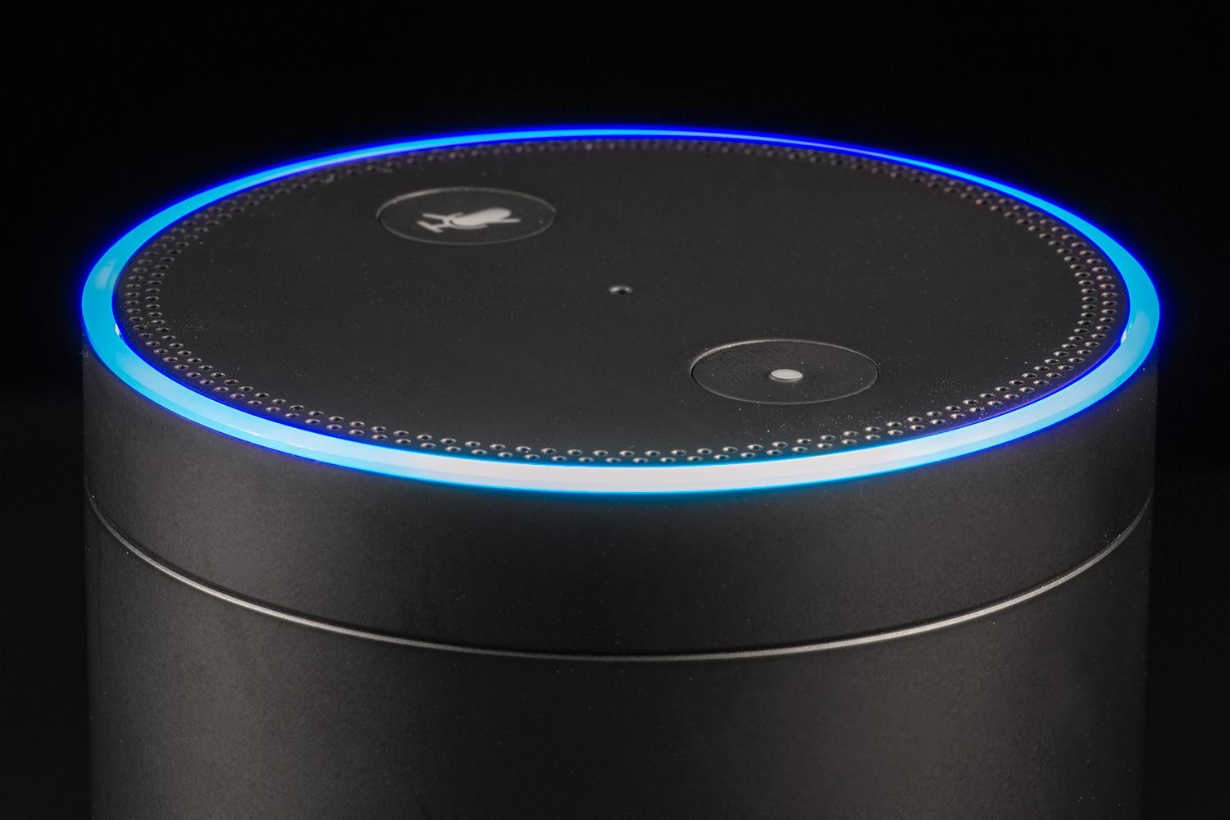
What is the Amazon Echo?

Slide 3
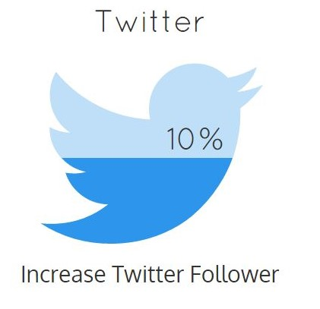

Objectives
1. Excitement
2. Exposure
3.Engagement
15,000 Facebook Likes
15%
10%
Notes:
Add photo or details here

Slide 4
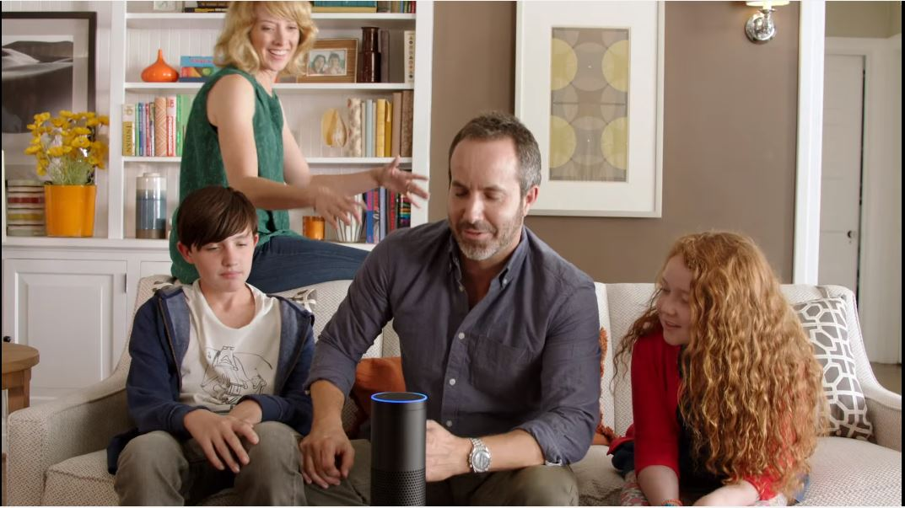
Target Audience
Primary Market
Age: 25 – 54
Income: $75,000+
Education: Some College
Psychographics
  Enjoys shopping online, Values time with family, Loves Music
Buying Behaviors
  Purchases new phone every year,
  Purchases smart home products
Purchase Drivers
  Latest and Greatest
Families

Slide 5

Target Audience
Secondary Market
Age: 25 – 54
Income: $75,000+
Education: Some College
Psychographics
  Lives life on a schedule, Always on the go
Buying Behaviors
  Purchases productivity apps
  Constantly orders supplies
Purchase Drivers
  Wants hands free experience, Lack of personal assistant
Business Professionals

Slide 6
Digital Strategy
Paid
Earned
Owned

Slide 7
Paid Media

Slide 8

Keywords
185,000,000
Notes:
Why? Need to talk about ctr and cpc

Slide 9




Display Advertising
80 Million Active Users
307 Million Active Users
A New Way to stay connected
1.6 Billion Active Users
A convenient way to make it easier to get through the day

Slide 10
Owned Media
Drive Engagement
Create Authority
Provide Relevancy
Enabling Accessibility

Slide 11
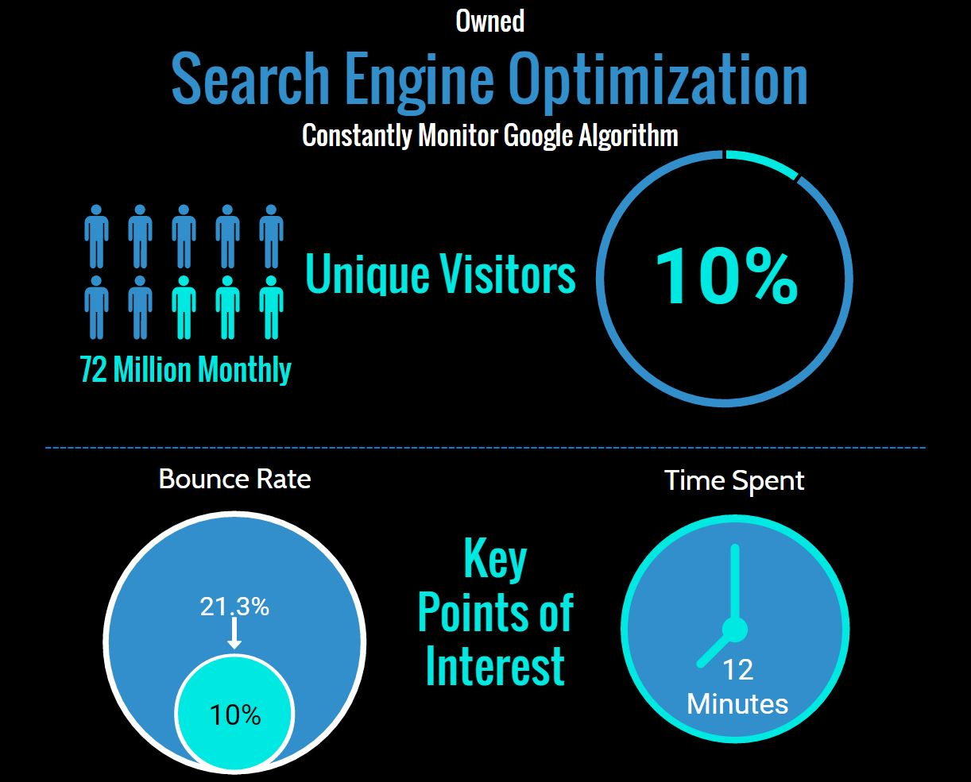

Slide 12




Relevant Inbound Links
4.8%
Facebook
21.5%
Google
Create Authority
2.6%
Yahoo!
2.6%
YouTube

Slide 13


Track AdWords Campaign
Track conversion of traffic from display ads
Track and Monitor Key Points of Interest

Slide 14


Objective Accomplished
Increase
CTR 10%

Slide 15
Earned Media

Slide 16
Social Media
Communicate with Customers
Announce New Features
Promotions & Games
#StayConnected
Notes:
Communicate – features they want added, new features coming soon, contest and games – secret phrase win an amazon gift cards.
Not in love with picture bubbles

Slide 17
Objective Accomplished
Quality
Content
Engagement
1,500 Facebook Likes
10% Follower Increase

Slide 18

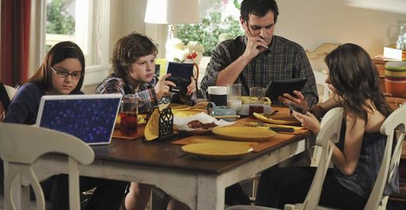
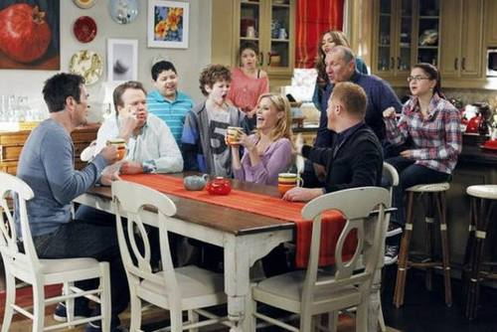

YouTube
Notes:
Story boards? 15 seconds?

Slide 19
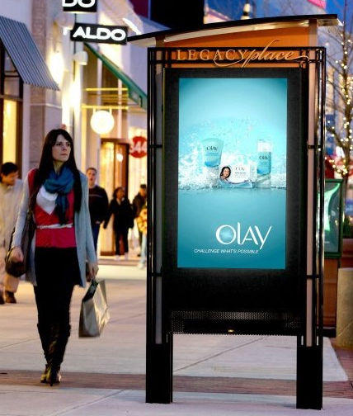

Interactive Display Boards
Ask Alexa Anything
Yelp
Pandora
Traffic Updates
Just Ask
Notes:
Story boards? 15 seconds?

Slide 20
Objective Accomplished
Excitement
Exposure
Just Ask
Engagement
15% Market Share

Slide 21
Budget
Includes Salary &
10% Agency Fees
AdWords $2.35 CPC @ 75,00 Impressions
Display Advertising $3.10
@ 55,00 Impressions
Notes:
Adwords $2.35 CPC 75,000 impressions/ Display Adv = $25,000 $3.10 CPC 55,000 impressions
Social

Slide 22

Schedule
October to December | January to March | April to June | July to August
Notes:
Finish changing metics

Slide 23
Our Team
Director
Account Manager
Coordinator 01
Coordinator 02
SEM Manager
Coordinator
SEO Manager

Slide 24


Recap
15%
Market Share

